Slide 1
Introduction to Web Technologies
JavaScript Revision
Lecturer: Christen Cao

Slide 2
Content
Object, Function & Expression
Conditionals & Relation
Number Systems

Slide 3
Content
Overview
Introduction to HTML
Tags, attributes, class/ID selector, CSS etc.
Introduction to JS
Input/output: prompt(…), alert(…);
Variable var & data types
– Variables：arithmetic operators: +
- * / % (modulo)
Conversion (strings -> numbers): Number(…); parseInt(...)
Math object: Math.sqrt(...), round(...), ceil(...), floor(...),
max(...,...), min(...,...), PI

Slide 4
Summary - Iteration, arrays, conditionals
Loop:
for
do … while
while …
Array
•
Logical operators &&, ||, !
Truth table
Operator precedence

Slide 5
Summary
Programmer-defined Function
Function declaration, call, returns
Formal/actual parameters
Variable scope: global vs local
HTML Forms

Slide 6
Q&A: nested loop
var v=1; for(i=1;i<5;i++)
for(j=2;j<5;j++)
v+=1;
alert(v);
13

Slide 7
Exercises 1.7
Take one number input from the user and find the smallest number which, when squared, is larger than the input number.
(assume that number in the question means a positive integer)
var input=Number(prompt("Enter an Integer:")); alert("answer = "+Math.ceil(Math.sqrt(input +1 )));
Examples: 2, 5, 10 …
Examples: 4, 9, 16

Slide 8
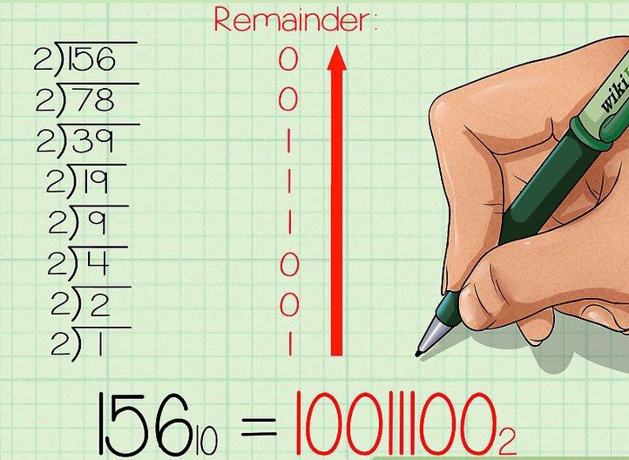
Exe: Convert a Decimal to Binary

Slide 9

Revision
Convert a price in USD to GBP
Creating & testing functions

Slide 10
Convert a price in USD to GBP
convert a price in USD to GBP
exchange rate 1 GBP=1.5 USD
Return the converted GBP value, or -1 in case of an error.
function convertToGBP(…){
…
}

Slide 11
Convert a price in USD to GBP
function convertToGBP(dollars) { var pounds = dollars / 1.22;
if( pounds >= 0 ) return pounds;
else
return -1;
}
alert( convertToGBP(100) ); alert( convertToGBP(-28) ); alert( convertToGBP('dollars') );

Slide 12
Asking Questions is a Hard Skill
It is a skill in itself.
University seeks to develop it and other “transferable” skills, including, most importantly, critical thinking.
It is vital to success in life.
It is recognized that it is hard, and something
many of us need to learn…
…but rewarded when done properly.

